Slide 1

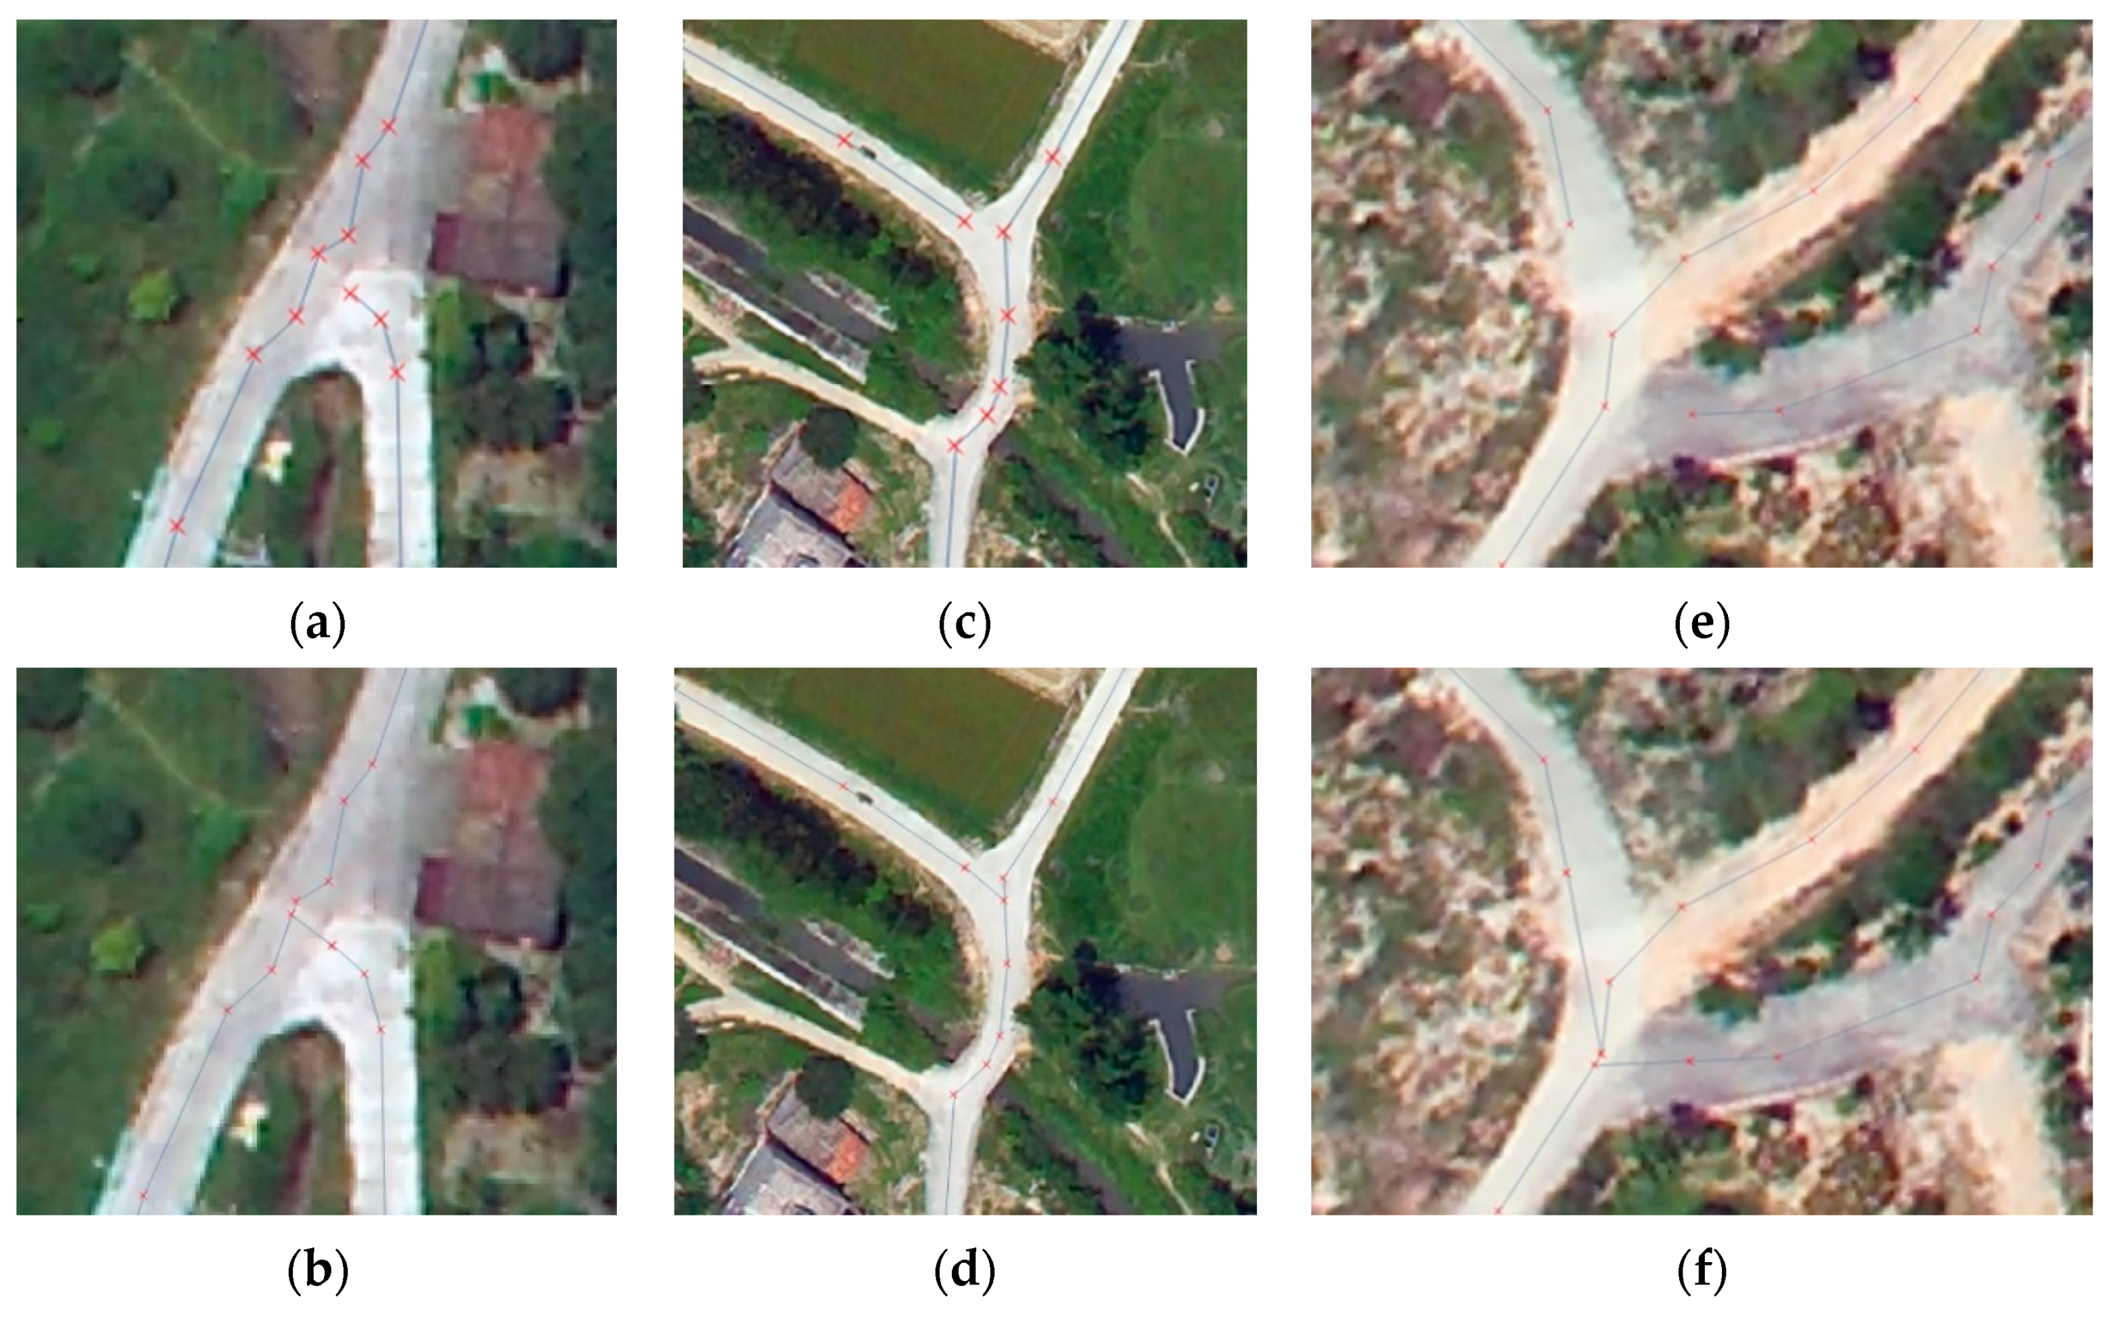
SMART INDIA HACKATHON (SIH) Automatic Road Extraction and alert generation for new roads
Problem Statement ID - 1564
Theme - Space Technology
PS Category - Hardware
Team ID -
Team Name - Spark Squad

Slide 2

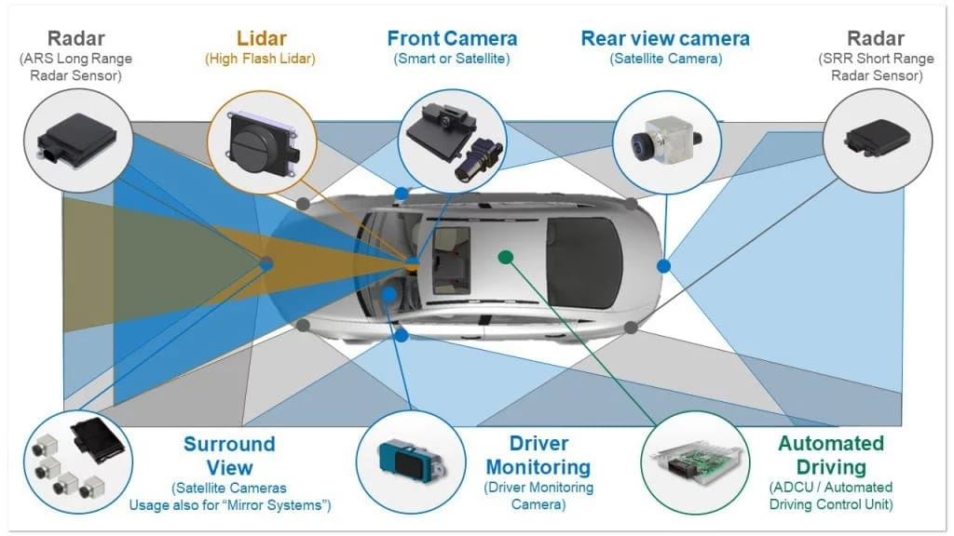
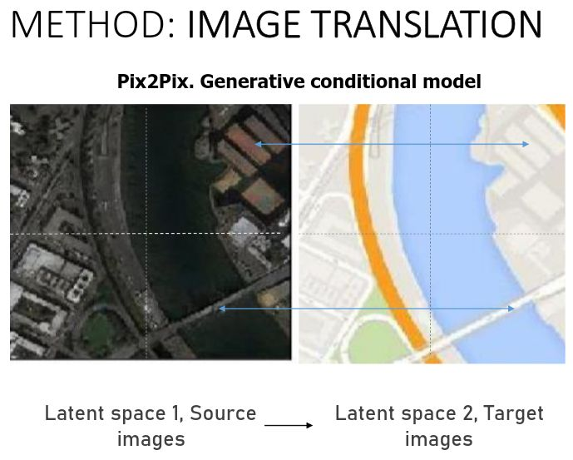
Automatic Road Detection
Automatic Road Detection is particularly employed in the city Planning, Cartography and to revise already detected roads in Geography information System Environment.
One unique thing it is the objective of road feature extraction method is providing a binary mask in which true pixels represents road regions and false pixels indicate non-road regions.
Automatic Road feature from high Resolution satellite image is required to detect the road network in a robust area.

Slide 3

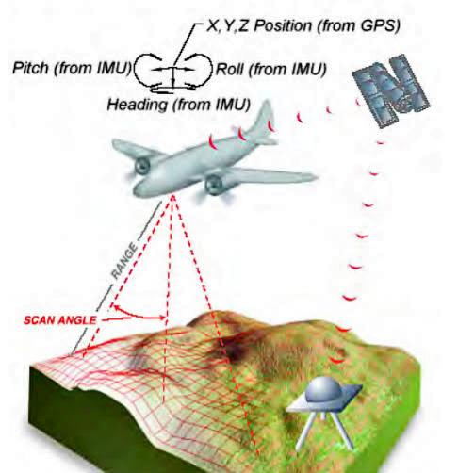
Technical Approach
One of the technologies used in Automatic Road Detection is LiDAR( Light Detection and Ranging)
LiDAR is an active sensing technique that uses light pulses to record a point cloud.
For each point accurate 3d coordinates among other information are provided like elevation information help to identify roads
Some other Technical approaches are Remote Sensing, Computer Vision, Image Processing, Data Fusion, Object-Based Image Analysis(OBIA), Artificial Intelligence(AI).
LiDAR consists of Laser, Scanner, Receiver, GPS, Processor, Power Supply.

Slide 4

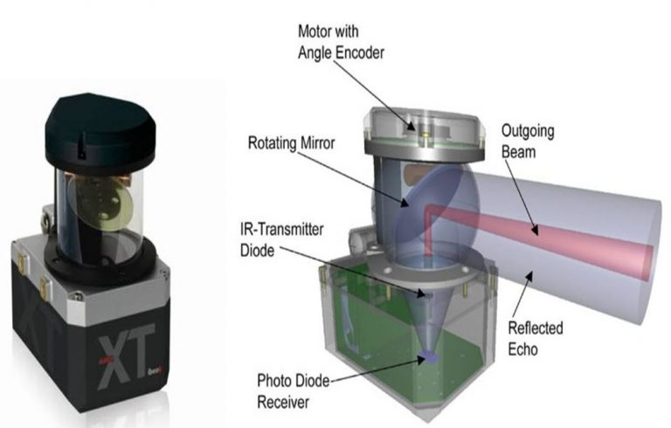
The below flowchart is the methodology & process for implementation
Input Satellite Image
One more method to deal it is -
A Collision Avoidance system (CAS) is a safety feature designed to prevent or mitigate collision between vehicles, pedestrians, or obstacles.
It also contains sensors, software, Alert system, Driver Monitoring.
The below figure is a diagram of LiDAR and its basic components.
Step 1: Pre-Planning
1.Erosion
2.Dilation
Step 2: Pre-Processing
Gaussian-Filtering
2. Convolution Overlap add method
Step 3: Gradient operation & Edge detection
Step 4: Colouring
Road Extracted Image

Slide 5

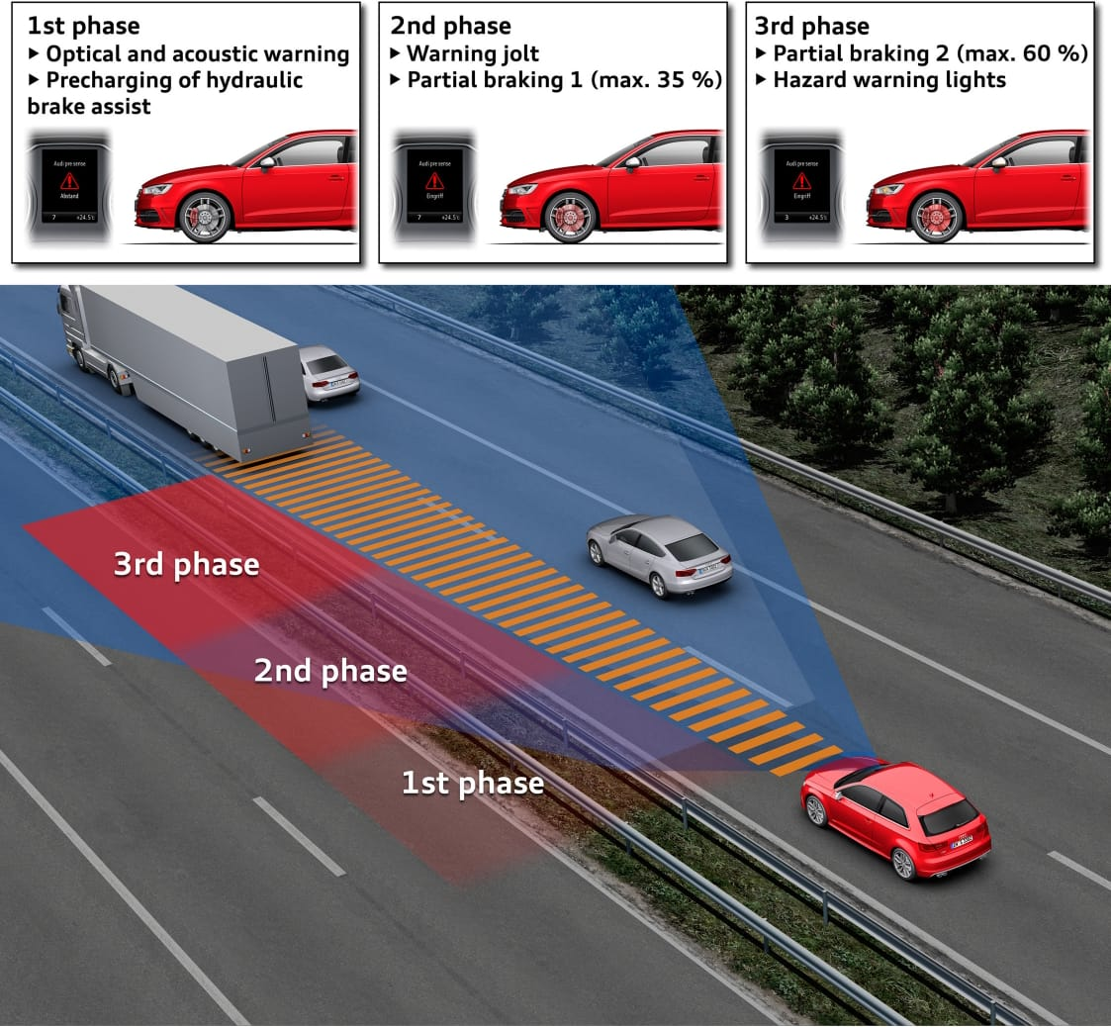
The major challenges of Road Extraction method is the complex structure and texture of the images, which contain many different objects such as Roads, Houses, Trees, Vehicles etc., with differences in shape, tone.
Image obtained from satellite are useful in much environment application such as tracking of Earth resources, Geographical mapping, and production of agricultural crops, urban growth, weather, flood and fire control are some of its potentials.
To overcome these challenges there are two types of extraction and can be classified into two types such as semi-automatic and fully automatic.
Some of its Benefits are that It improves Navigation and Routing, Enhance Urban Planning, Disaster Response and Recovery, Environmental Monitoring, Infrastructure Safety, Land Use Planning, Research & Analysis.
Collision avoidance system is the system used to reduce fatal accidents by immediate breaking systems

Slide 6

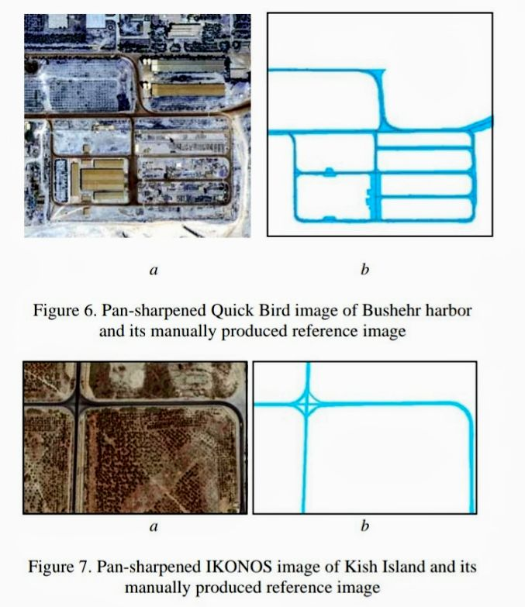
In order to evaluate the functionality of the Road Extraction Method proposed in this research two sub samples of pan-sharpened Quick Birds and IKONOS images from Bushehr Harbour and Kish islands in Iran were used as case study. Manually produced reference image applied in accuracy assessment procedure.
Reference
H. R. R. Bakhtiari, A. Abdollahi, and H. Rezaeian, “Semi automatic
road extraction from digital images,” Egypt. J. Remote Sens. Space Sci.,
vol. 20, no. 1, pp. 117–123, 2017.
[2] G. Panteras and G. Cervone, “Enhancing the temporal resolution of
satellite-based flood extent generation using crowdsourced data for dis-
aster monitoring,” Int. J. Remote Sens., vol. 39, no. 5, pp. 1459–1474,
2018.
[3] Z. Zhu, S. Yang, G. Xu, X. Lin, and D. Shi, “Fast road classification and
orientation estimation using omni-view images and neural networks,”
IEEE Trans. Image Process., vol. 7, no. 8, pp. 1182–1197, Aug. 1998.
[4] J. Wang, J. Song, M. Chen, and Y. Zhi, “Road network extraction: A
neural-dynamic framework based on deep learning and a finite state
machine,” Int. J. Remote Sens., vol. 36, no. 12, pp. 3144–3169, 2015.
[5] W. Shi, Z. Miao, and J. Debayle, “An integrated method for urban main-
road centerline extraction from optical remote sensed imagery,” IEEE
Trans. Geosci. Remote Sens., vol. 52, no. 6, pp. 3359–3372, Jun. 2014.
[6] S. Saito, T. Yamashita, and Y. Aoki, “Multiple object extraction from
aerial imagery with convolutional neural networks,” J. Imag. Sci. Tech-
nol., vol. 60, no. 1, pp. 10402–10409, 2016.

